Slide 1
Convolutional Neural Networks
Jin Lu – UMDearborn

Slide 2
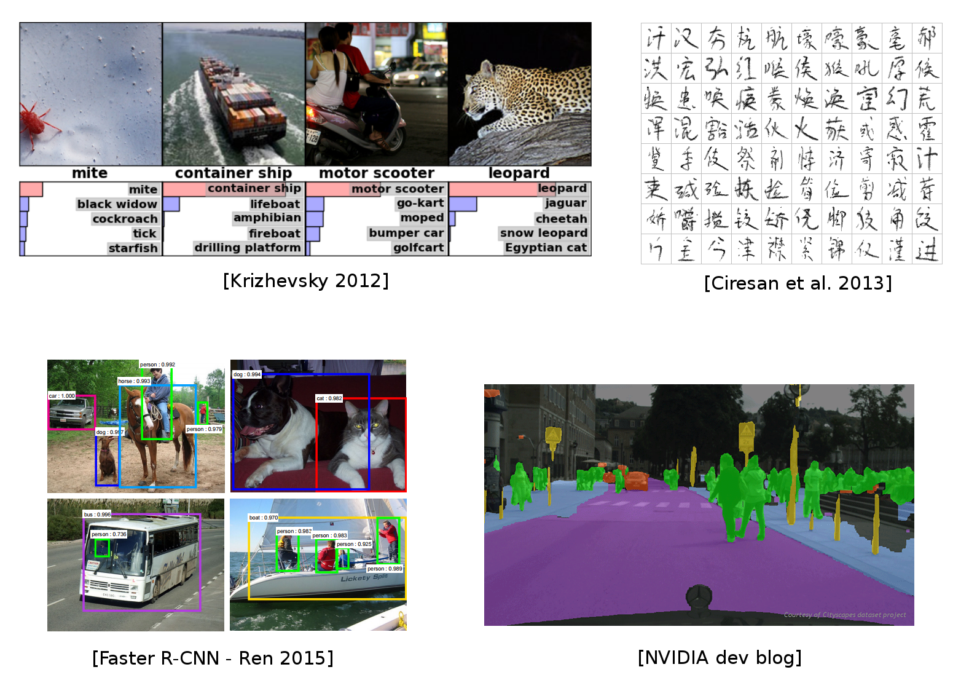
Used everywhere for Vision
Embeddings

Slide 3
Many other applications
Speech recognition & speech synthesis

Slide 4
Many other applications
Speech recognition & speech synthesis
Natural Language Processing

Slide 5
Many other applications
Speech recognition & speech synthesis
Natural Language Processing
Protein/DNA binding prediction

Slide 6
Many other applications
Speech recognition & speech synthesis
Natural Language Processing
Protein/DNA binding prediction
Any problem with a spatial (or sequential) structure

Slide 7
ConvNets for image classification
CNN = Convolutional Neural Networks = ConvNet

Slide 8
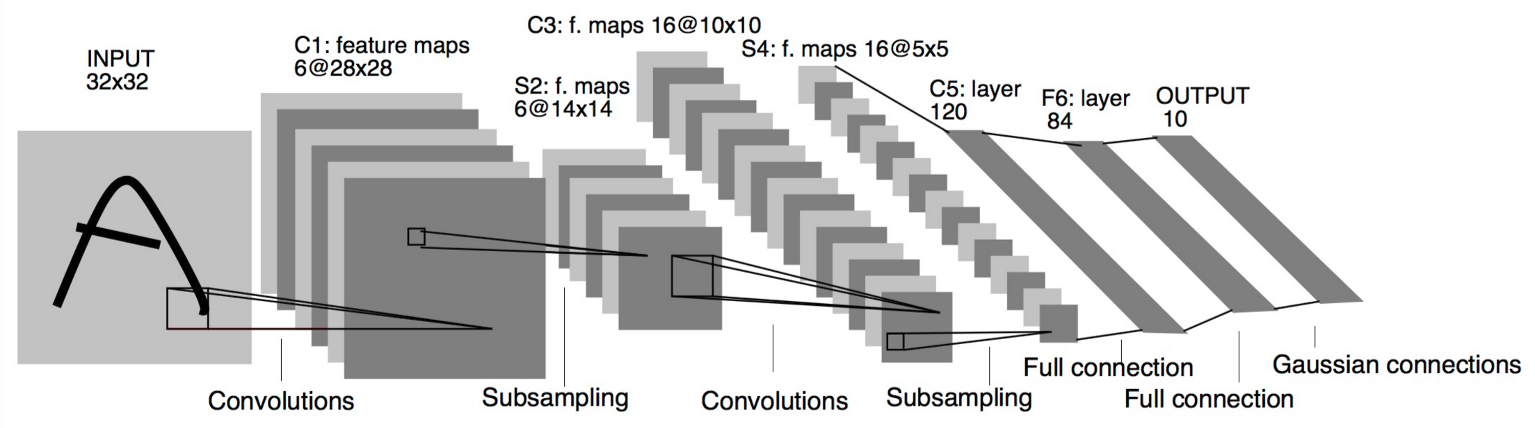
ConvNets for image classification
CNN = Convolutional Neural Networks = ConvNet
LeCun, Y., Bottou, L., Bengio, Y., and Haffner, P. (1998). Gradient-based learning applied to document recognition.

Slide 9
Outline
Convolutions

Slide 10
Outline
Convolutions
CNNs for Image Classification

Slide 11
Outline
Convolutions
CNNs for Image Classification
CNN Architectures

Slide 12
Convolutions

Slide 13
Motivations
Standard Dense Layer for an image input:
x = Input((640, 480, 3), dtype='float32')
# shape of x is: (None, 640, 480, 3)
x = Flatten()(x)
# shape of x is: (None, 640 x 480 x 3)
z = Dense(1000)(x)

Slide 14
Motivations
Standard Dense Layer for an image input:
x = Input((640, 480, 3), dtype='float32')
# shape of x is: (None, 640, 480, 3)
x = Flatten()(x)
# shape of x is: (None, 640 x 480 x 3)
z = Dense(1000)(x)
How many parameters in the Dense layer?

Slide 15
Motivations
Standard Dense Layer for an image input:
x = Input((640, 480, 3), dtype='float32')
# shape of x is: (None, 640, 480, 3)
x = Flatten()(x)
# shape of x is: (None, 640 x 480 x 3)
z = Dense(1000)(x)
How many parameters in the Dense layer?
640×480×3×1000+1000=922M!

Slide 16
Motivations
Standard Dense Layer for an image input:
x = Input((640, 480, 3), dtype='float32')
# shape of x is: (None, 640, 480, 3)
x = Flatten()(x)
# shape of x is: (None, 640 x 480 x 3)
z = Dense(1000)(x)
How many parameters in the Dense layer?
640×480×3×1000+1000=922M!
Spatial organization of the input is destroyed by Flatten

Slide 17
Motivations
Standard Dense Layer for an image input:
x = Input((640, 480, 3), dtype='float32')
# shape of x is: (None, 640, 480, 3)
x = Flatten()(x)
# shape of x is: (None, 640 x 480 x 3)
z = Dense(1000)(x)
How many parameters in the Dense layer?
640×480×3×1000+1000=922M!
Spatial organization of the input is destroyed by Flatten
We never use Dense layers directly on large images. Most standard solution is convolution layers

Slide 18
Fully Connected Network: MLP
input_image = Input(shape=(28, 28, 1))
x = Flatten()(input_image)
x = Dense(256, activation='relu')(x)
x = Dense(10, activation='softmax')(x)
mlp = Model(inputs=input_image, outputs=x)

Slide 19
Fully Connected Network: MLP
input_image = Input(shape=(28, 28, 1))
x = Flatten()(input_image)
x = Dense(256, activation='relu')(x)
x = Dense(10, activation='softmax')(x)
mlp = Model(inputs=input_image, outputs=x)
Convolutional Network
input_image = Input(shape=(28, 28, 1))
x = Conv2D(32, 5, activation='relu')(input_image)
x = MaxPool2D(2, strides=2)(x)
x = Conv2D(64, 3, activation='relu')(x)
x = MaxPool2D(2, strides=2)(x)
x = Flatten()(x)
x = Dense(256, activation='relu')(x)
x = Dense(10, activation='softmax')(x)
convnet = Model(inputs=input_image, outputs=x)

Slide 20
Fully Connected Network: MLP
input_image = Input(shape=(28, 28, 1))
x = Flatten()(input_image)
x = Dense(256, activation='relu')(x)
x = Dense(10, activation='softmax')(x)
mlp = Model(inputs=input_image, outputs=x)
Convolutional Network
input_image = Input(shape=(28, 28, 1))
x = Conv2D(32, 5, activation='relu')(input_image)
x = MaxPool2D(2, strides=2)(x)
x = Conv2D(64, 3, activation='relu')(x)
x = MaxPool2D(2, strides=2)(x)
x = Flatten()(x)
x = Dense(256, activation='relu')(x)
x = Dense(10, activation='softmax')(x)
convnet = Model(inputs=input_image, outputs=x)
2D spatial organization of features preserved untill Flatten.

Slide 21
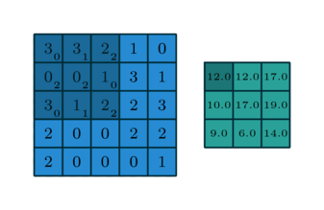
Convolution in a neural network
X (kernel) is a 3×3 chunk (dark area) of the image (blue array)
Each output neuron is parametrized with the 3×3 weight matrix w (small numbers)
Kernel matrix used in above example is:
0 1 2
2 2 0
0 1 2
Notes:
Need to initialize the values inside of the kernel
5x5 image, 3x3 kernel; output matrix (feature map) will have size of 3x3
General Formula to calculate resulting feature map is: input size – output size +1
If we used a fully connected MLP (multilayer perceptron) we would have 25*9 + 9 parameters (the +9 comes from bias)
But with convolutional neural network: we need to train only 9 parameters total.

Slide 22

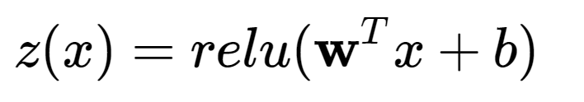
Convolution in a neural network
x is a 3×3 chunk (dark area) of the image (blue array)
Each output neuron is parametrized with the 3×3 weight matrix w (small numbers)
The activation obtained by sliding the 3×3 window and computing:
Notes:
w^T means matrix w transposed (turn it into a vector)
Note, kernel sliding window can go outside of the image input but then you would need to pad the image with values (such as 0s).

Slide 23
Motivations
Local connectivity
A neuron depends only on a few local input neurons
Translation invariance
Reduce sensitivity of the model so that small changes to the image will not affect output too much. This is generally a good thing: think about analyzing frames → you cannot guarantee all inputs will be exactly the same, so you want to reduce accuracy so that you do not have to start over with your computation analysis just because of a small change in the data frames being analyzed.

Slide 24
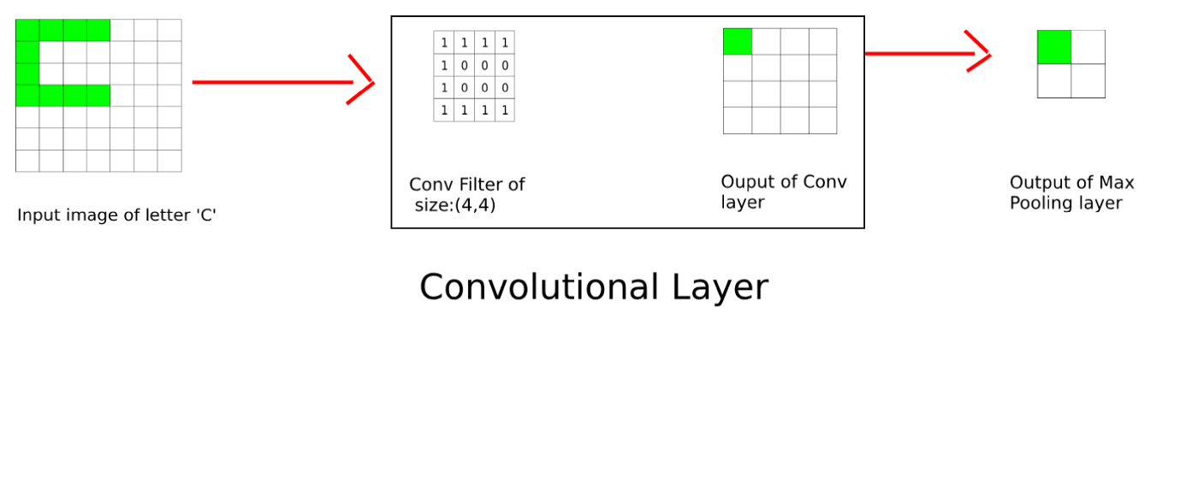
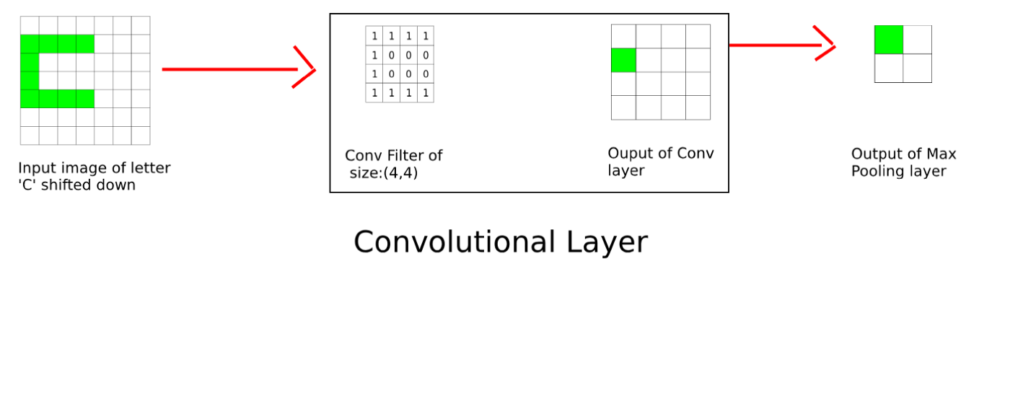
Motivations
Local connectivity
A neuron depends only on a few local input neurons
Translation invariance
Notes:
Reduce an image to a set of features and the respective positions in the image
Max pooling layer: pick highest number in the 2x2 grid.
Notice, highest activation shown in green of the output of conv sum all values and then choose the quadrant with the highest sum.

Slide 25
Motivations
Local connectivity
A neuron depends only on a few local input neurons
Translation invariance
Comparison to Fully connected
Parameter sharing: reduce overfitting
Make use of spatial structure: strong prior for vision!

Slide 26
Motivations
Local connectivity
A neuron depends only on a few local input neurons
Translation invariance
Comparison to Fully connected
Parameter sharing: reduce overfitting
Make use of spatial structure: strong prior for vision!
Animal Vision Analogy
Hubel & Wiesel, RECEPTIVE FIELDS OF SINGLE NEURONES IN THE CAT'S STRIATE CORTEX (1959)
Notes:
Reasonable that convolutional neural network for vision system because that is how God has designed human and animal vision according to our understanding.

Slide 27
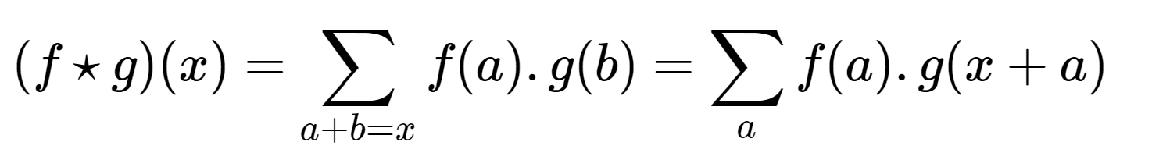
Why Convolution
Discrete convolution (actually cross-correlation) between two functions f and g:
Notes:
Think of f as kernel, and g as original image.
Above equation just showing that for many signal processing we use Fourier transformations (convolution networks) since we do not need so much granularity that will only slow down computation that would be good enough for some purpose.
Image processing or sensor processing in general are good candidates for using convolutional neural networks.

Slide 28
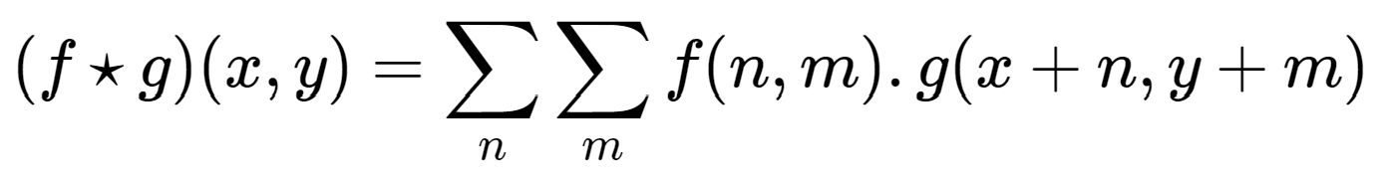
Why Convolution
Discrete convolution (actually cross-correlation) between two functions f and g:
2D-convolutions (actually 2D cross-correlation):

Slide 29
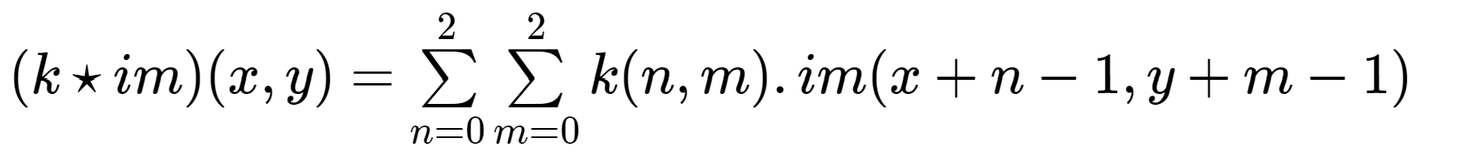
Example: convolution image
Image: im of dimensions 5×5
Kernel: k of dimensions 3×3

Slide 30
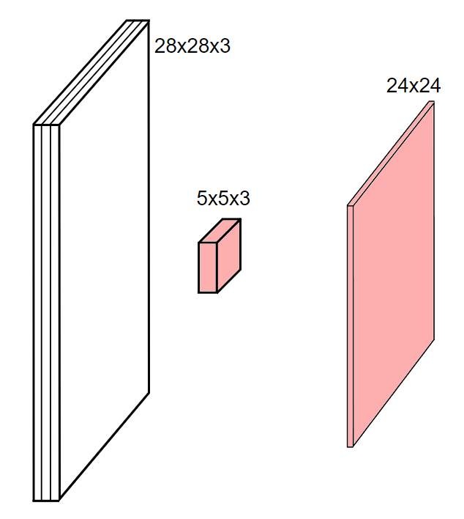
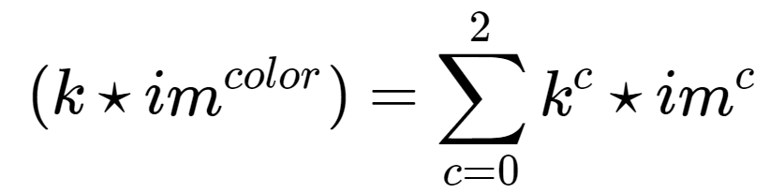
Channels
Colored image = tensor of shape (height, width, channels)
Convolutions are usually computed for each channel and summed:
Notes:
3-way tensor: 3d cubic matrix
Height 28, weight 28, channel = 3 (RGB)
5x5x3 cube = the kernel
So R should be convolved with 1st channel in kernel, G with 2nd, B with 3rd
Then convolutions for each channel are summed
Output will then be 24x24
28x28 input with 5x5, thus 28-5 +1 = 24 x24 output.

Slide 31
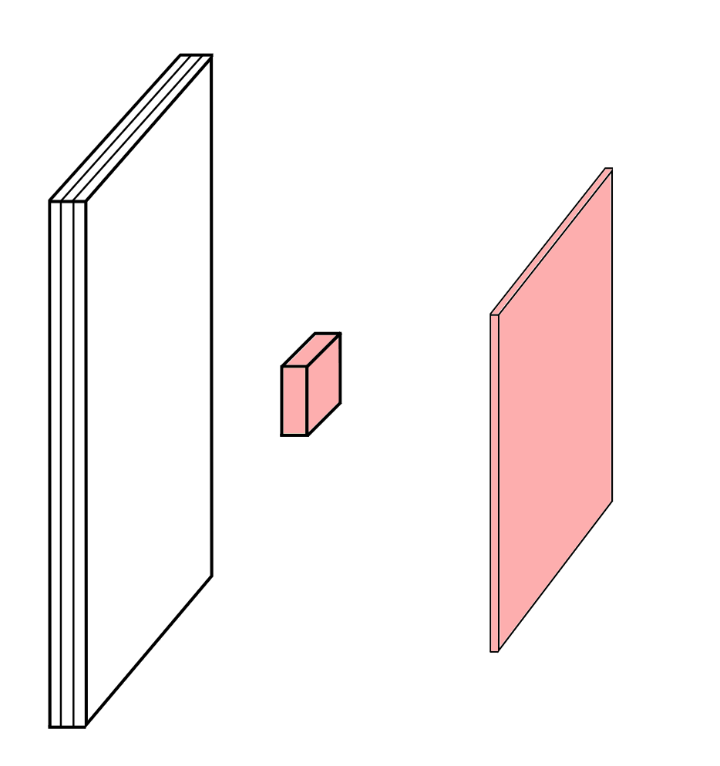
Multiple convolutions

Slide 32
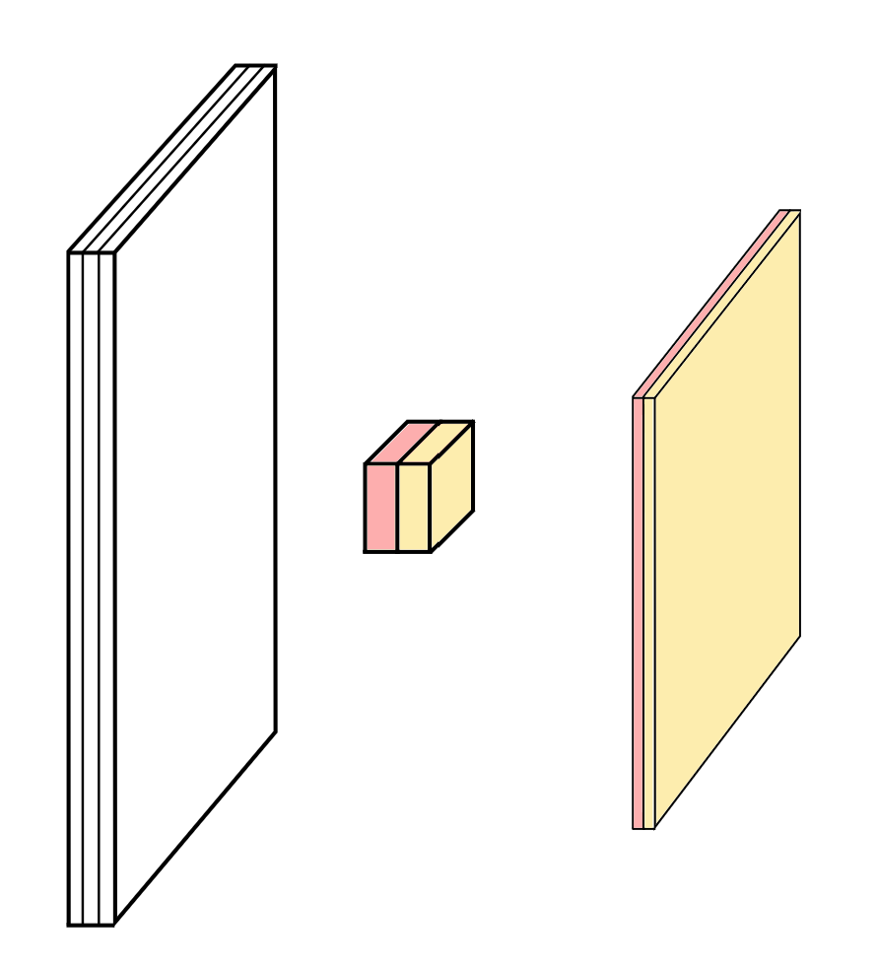
Multiple convolutions

Slide 33
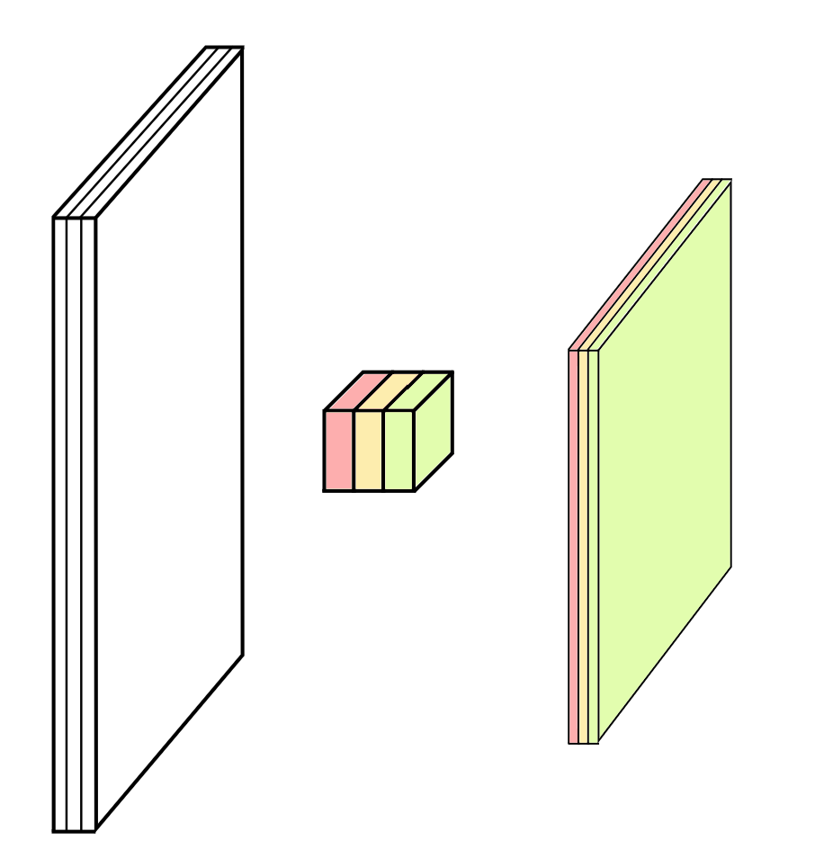
Multiple convolutions

Slide 34
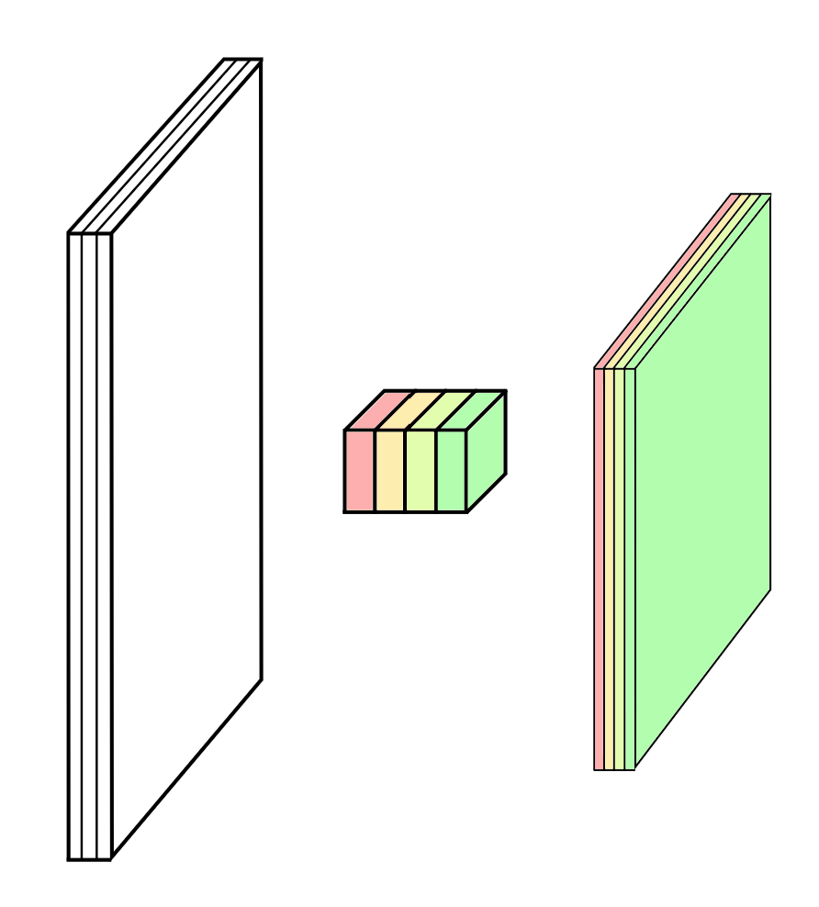
Multiple convolutions
Notes:
Hyper resolution image → more than 3 channels (for example, military or commercial satellites) since RGB has very limited accuracy of color.
RGB is limited by 8 bits per color (manages brightness) → 2^8 – 1 = 255 → 255*255*255 is the number of combinations of RGB brightness that can be had.
Can also do super resolution: increase image resolution from for example 200x200 to 400x400.

Slide 35
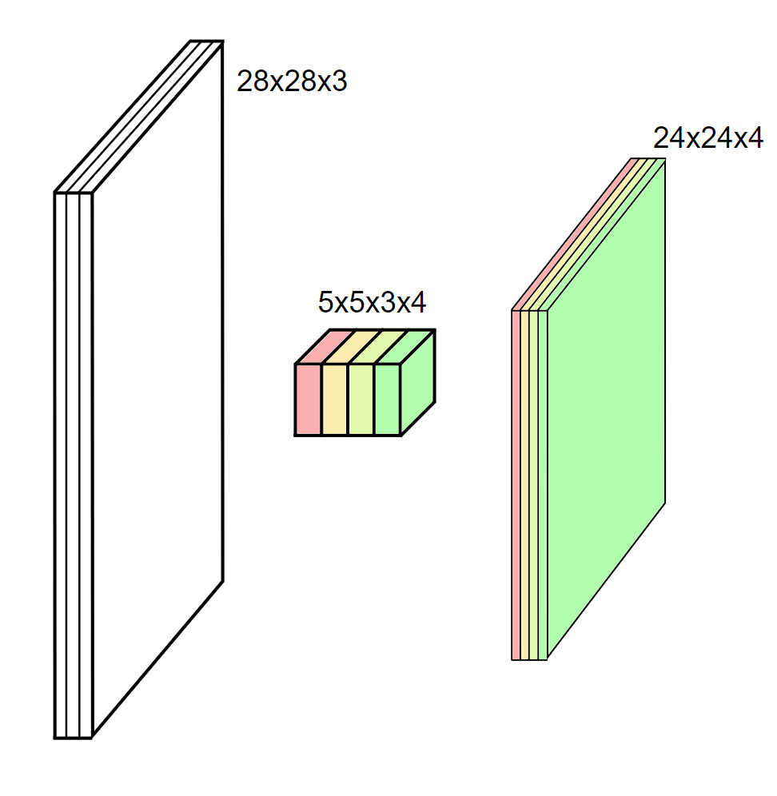
Multiple convolutions
Kernel size aka receptive field (usually 1, 3, 5, 7, 11)
Output dimension: length - kernel_size + 1
Notes:
5x5x3x4 → first argument is w, second is h, next is channel, last is out-channel (output channel).
Typically choose small sliding window because of memory overflow.
Each slice from input and output has a set of specific features.
When you have more kernels, you can extract more features.

Slide 36

Strides
Strides: increment step size for the convolution operator
Larger strides = Reduces the size of the output map
Example with kernel size 3×3 and a stride of 2 (image in blue)
Notes:
Moving stride is 1 by default
Decreases feature extraction efficiency with larger strides since parts of image is ignored

Slide 37

Padding
Padding: artificially fill borders of image
Useful to keep spatial dimension constant across filters
Useful with strides and large receptive fields (may need to generalize more if reception/input matrix is large)
Usually: fill with 0s

Slide 38
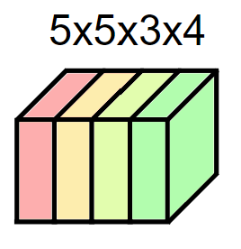
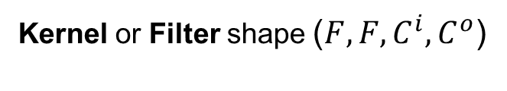
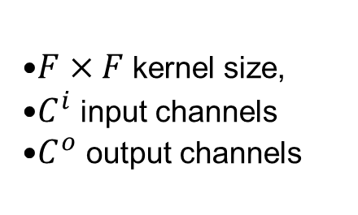
Dealing with shapes
Kernel or Filter shape ($F,F,C^{i},C^{o}$)
$F×F$kernel size,
$C^{i}$ input channels
$C^{o}$ output channels

Slide 39
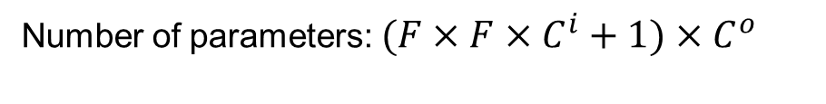
Dealing with shapes
Kernel or Filter shape ($F,F,C^{i},C^{o}$)
$F×F$kernel size,
$C^{i}$ input channels
$C^{o}$ output channels
Number of parameters: $(F×F×C^{i}+1)×C^{o}$
Notes:
+1 to consider bias

Slide 40
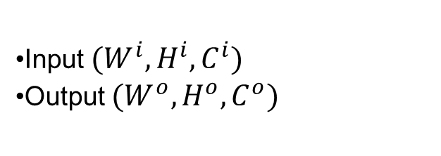
Dealing with shapes
Kernel or Filter shape ($F,F,C^{i},C^{o}$)
$F×F$kernel size,
$C^{i}$ input channels
$C^{o}$ output channels
Number of parameters: $(F×F×C^{i}+1)×C^{o}$
Activations or Feature maps shape:
Input $(W^{i},H^{i},C^{i})$
Output $(W^{o},H^{o},C^{o})$

Slide 41
Dealing with shapes
Kernel or Filter shape ($F,F,C^{i},C^{o}$)
$F×F$kernel size,
$C^{i}$ input channels
$C^{o}$ output channels
Number of parameters: $(F×F×C^{i}+1)×C^{o}$
Activations or Feature maps shape:
Input $(W^{i},H^{i},C^{i})$
Output $(W^{o},H^{o},C^{o})$
$$W^{o}=(W^{i}−F+2P)/S+1$$
Notes:
P refers to the padding size
S refers to stride length
W and H refers to width and height.

Slide 42
Pooling
Spatial dimension reduction
Local invariance
No parameters: max or average of 2x2 units

Slide 43
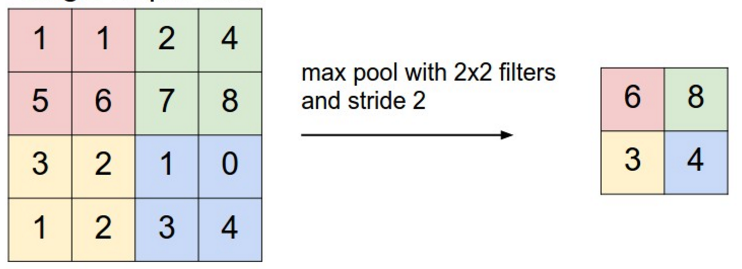
Pooling
Spatial dimension reduction
Local invariance
No parameters: max or average of 2x2 units
Schematic from Stanford http://cs231n.github.io/convolutional-networks
Notes:
Pooling can reduce noise

Slide 44
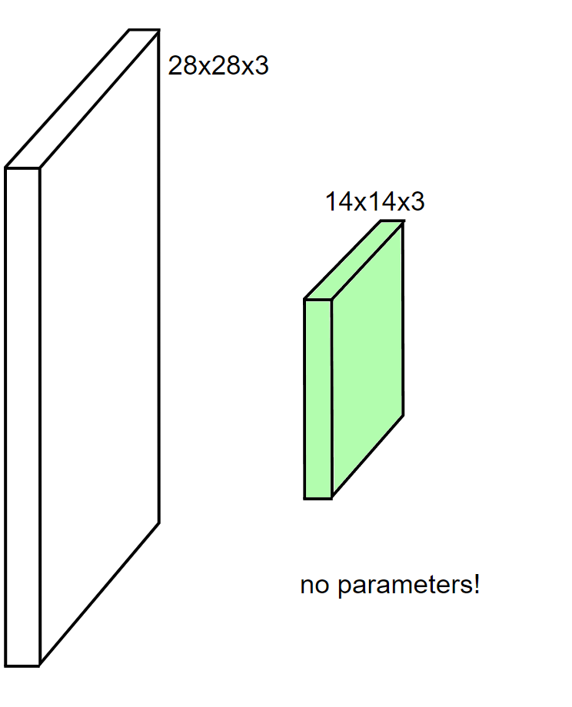
Pooling
Spatial dimension reduction
Local invariance
No parameters: max or average of 2x2 units

Slide 45
Architectures

Slide 46
Classic ConvNet Architecture
Input

Slide 47
Classic ConvNet Architecture
Input
Conv blocks
Convolution + activation (relu)
Convolution + activation (relu)
...
Maxpooling 2x2

Slide 48
Classic ConvNet Architecture
Input
Conv blocks
Convolution + activation (relu)
Convolution + activation (relu)
...
Maxpooling 2x2
Output
Fully connected layers
Softmax

Slide 49
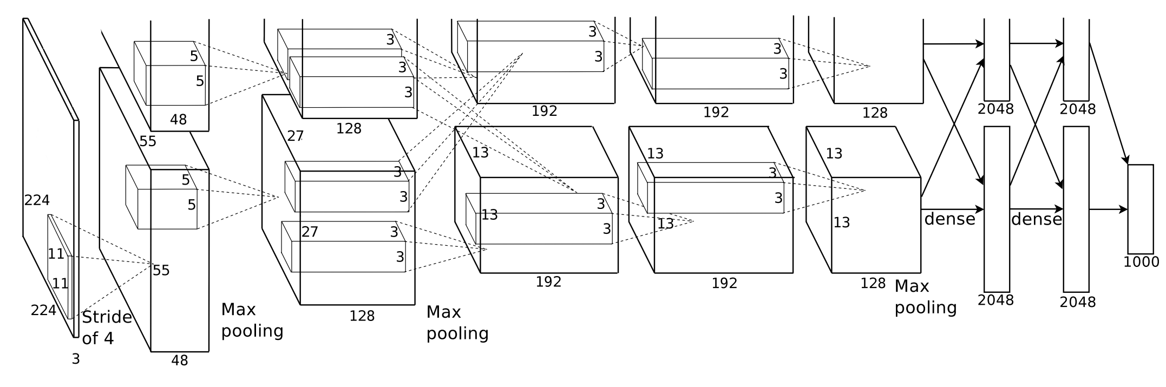
AlexNet
Simplified version of Krizhevsky, Alex, Sutskever, and Hinton. "Imagenet classification with deep convolutional neural networks." NIPS 2012

Slide 50
AlexNet
First conv layer: kernel 11x11x3x96 stride 4
Simplified version of Krizhevsky, Alex, Sutskever, and Hinton. "Imagenet classification with deep convolutional neural networks." NIPS 2012

Slide 51
AlexNet
First conv layer: kernel 11x11x3x96 stride 4
Kernel shape: (11,11,3,96)
Output shape: (55,55,96)
Number of parameters: 34,944
Equivalent MLP parameters: 43.7 x 1e9
Simplified version of Krizhevsky, Alex, Sutskever, and Hinton. "Imagenet classification with deep convolutional neural networks." NIPS 2012

Slide 52
AlexNet
INPUT: [227x227x3]
CONV1: [55x55x96] 96 11x11 filters at stride 4, pad 0
MAX POOL1: [27x27x96] 3x3 filters at stride 2
CONV2: [27x27x256] 256 5x5 filters at stride 1, pad 2
MAX POOL2: [13x13x256] 3x3 filters at stride 2
CONV3: [13x13x384] 384 3x3 filters at stride 1, pad 1
CONV4: [13x13x384] 384 3x3 filters at stride 1, pad 1
CONV5: [13x13x256] 256 3x3 filters at stride 1, pad 1
MAX POOL3: [6x6x256] 3x3 filters at stride 2
FC6: [4096] 4096 neurons
FC7: [4096] 4096 neurons
FC8: [1000] 1000 neurons (softmax logits)
Notes:
Dense = dense layer = fully connected MLP
Use dense layer at the end for regression in order to help classify/cluster extracted features from convoluted layers.

Slide 53
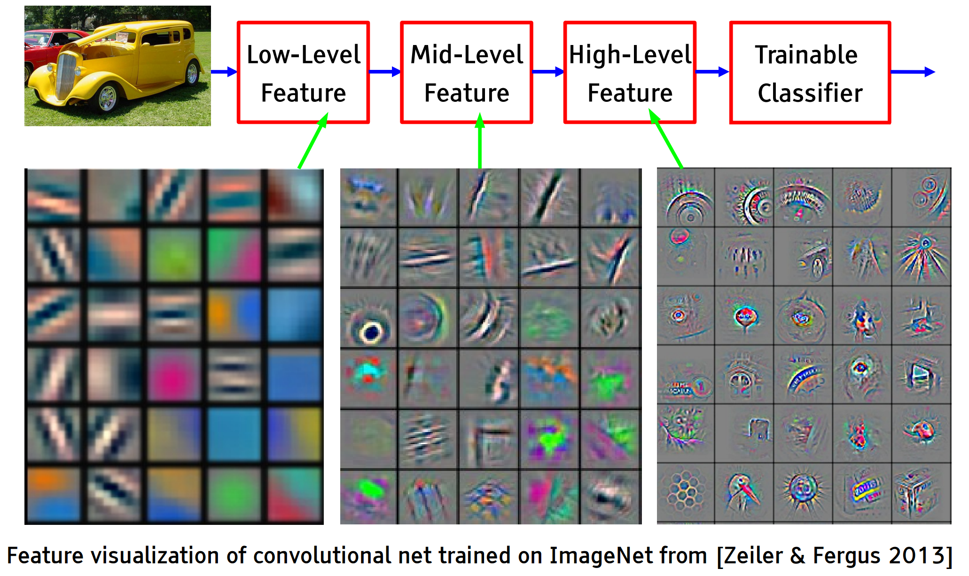
Hierarchical representation
Hierarchical representation

Slide 54
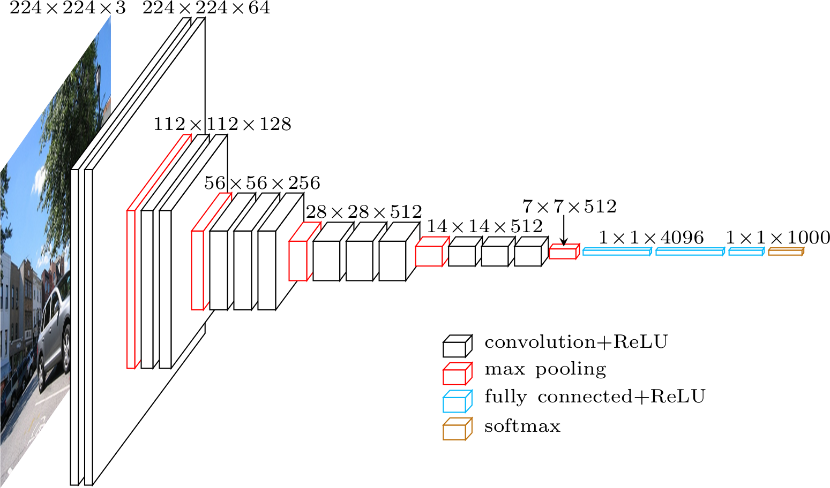
VGG-16
Simonyan, Karen, and Zisserman. "Very deep convolutional networks for large-scale image recognition." (2014)

Slide 55
VGG in Keras
model.add(Convolution2D(64, 3, 3, activation='relu',input_shape=(3,224,224)))
model.add(Convolution2D(64, 3, 3, activation='relu'))
model.add(MaxPooling2D((2,2), strides=(2,2)))
model.add(Convolution2D(128, 3, 3, activation='relu'))
model.add(Convolution2D(128, 3, 3, activation='relu'))
model.add(MaxPooling2D((2,2), strides=(2,2)))
model.add(Convolution2D(256, 3, 3, activation='relu'))
model.add(Convolution2D(256, 3, 3, activation='relu'))
model.add(Convolution2D(256, 3, 3, activation='relu'))
model.add(MaxPooling2D((2,2), strides=(2,2)))
model.add(Convolution2D(512, 3, 3, activation='relu'))
model.add(Convolution2D(512, 3, 3, activation='relu'))
model.add(Convolution2D(512, 3, 3, activation='relu'))
model.add(MaxPooling2D((2,2), strides=(2,2)))
model.add(Convolution2D(512, 3, 3, activation='relu'))
model.add(Convolution2D(512, 3, 3, activation='relu'))
model.add(Convolution2D(512, 3, 3, activation='relu'))
model.add(MaxPooling2D((2,2), strides=(2,2)))
model.add(Flatten())
model.add(Dense(4096, activation='relu'))
model.add(Dropout(0.5))
model.add(Dense(4096, activation='relu'))
model.add(Dropout(0.5))
model.add(Dense(1000, activation='softmax'))

Slide 56
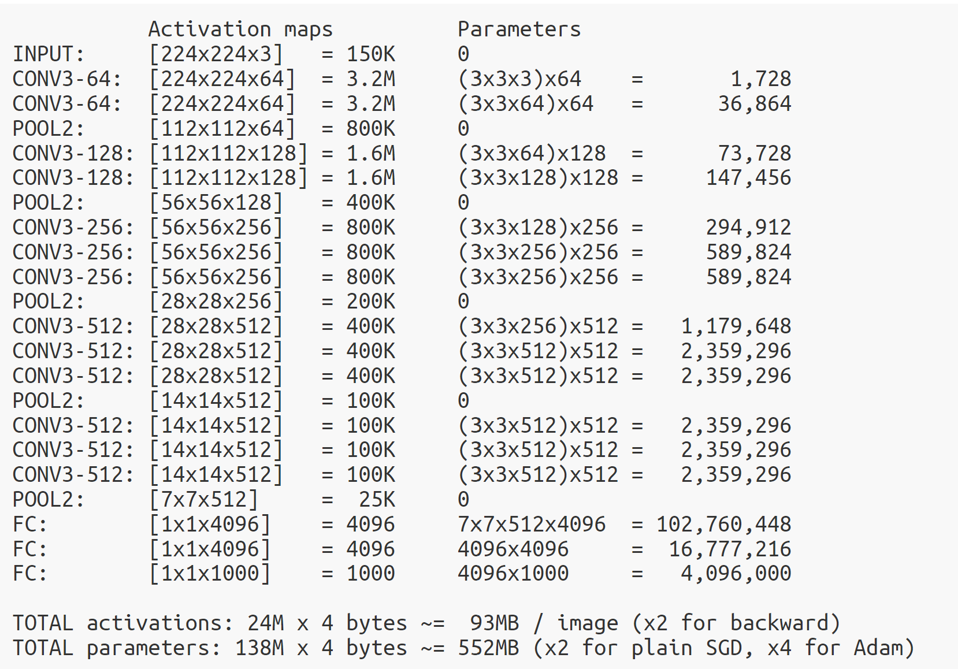
Memory and Parameters

Slide 57
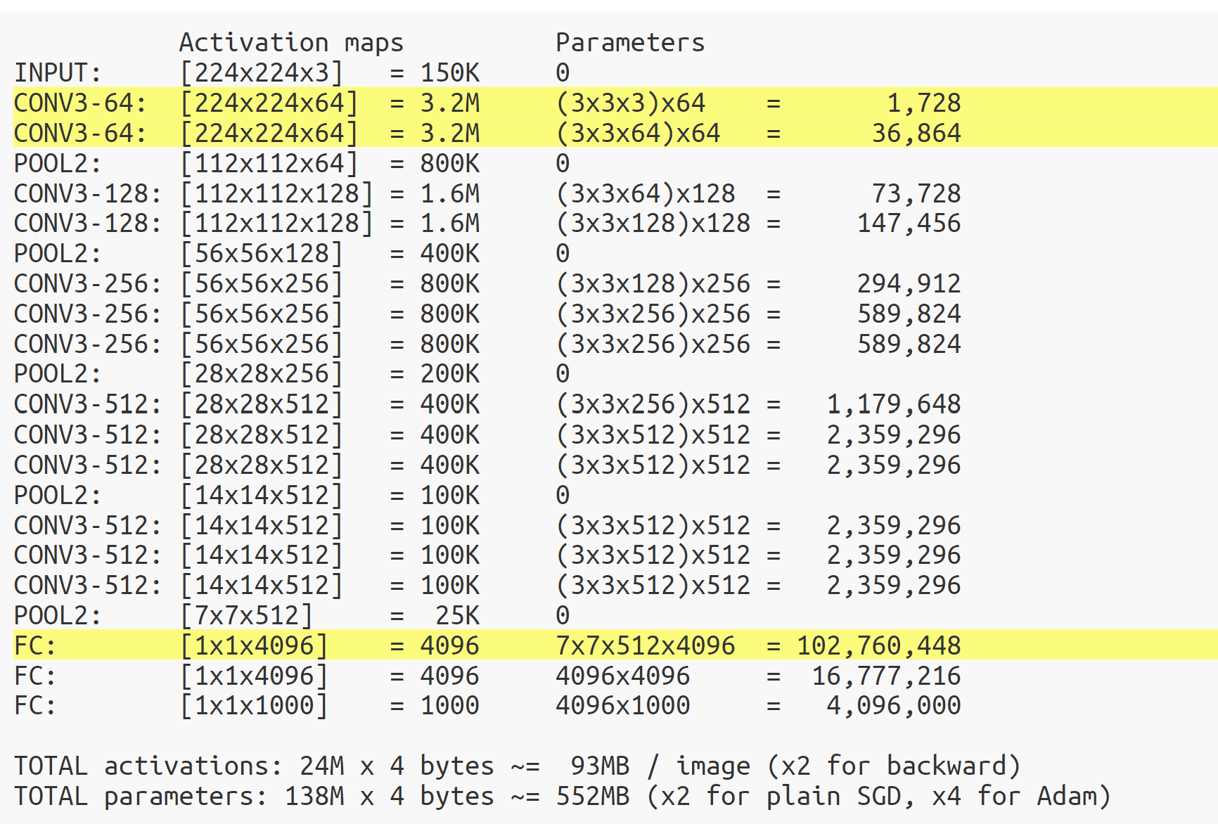
Memory and Parameters

Slide 58
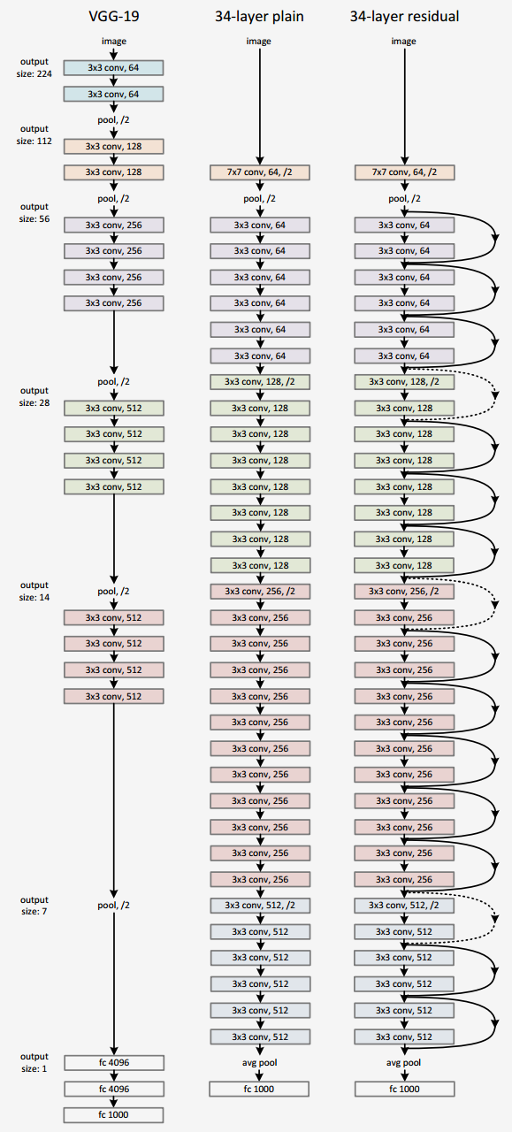
ResNet
Even deeper models:
34, 50, 101, 152 layers
He, Kaiming, et al. "Deep residual learning for image recognition." CVPR. 2016.
Notes:
Usually, when too many parameters are present, a model loses generalization ability (due to overfitting); but ResNet (through deep connections (the loops as shown), called boosting) can still do well at generalizations.
Standard deep learning model: x_t+1 = x_t + h(x_t)
With ResNet: x_t+1 = x_t + h(x_t)

Slide 59
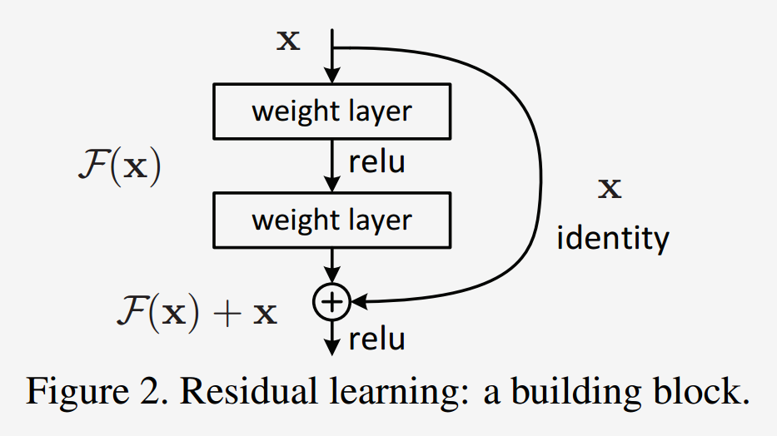
ResNet
A block learns the residual w.r.t. identity
He, Kaiming, et al. "Deep residual learning for image recognition." CVPR. 2016.

Slide 60
ResNet (residual network)
A block learns the residual w.r.t. identity
Good optimization properties
He, Kaiming, et al. "Deep residual learning for image recognition." CVPR. 2016.

Slide 61
ResNet
ResNet50 Compared to VGG:
Superior accuracy in all vision tasks 5.25% top-5 error vs 7.1%

Slide 62
ResNet
ResNet50 Compared to VGG:
Superior accuracy in all vision tasks 5.25% top-5 error vs 7.1%
Less parameters 25M vs 138M

Slide 63
ResNet
ResNet50 Compared to VGG:
Superior accuracy in all vision tasks 5.25% top-5 error vs 7.1%
Less parameters 25M vs 138M
Computational complexity 3.8B Flops vs 15.3B Flops

Slide 64
ResNet
ResNet50 Compared to VGG:
Superior accuracy in all vision tasks 5.25% top-5 error vs 7.1%
Less parameters 25M vs 138M
Computational complexity 3.8B Flops vs 15.3B Flops
Fully Convolutional until the last layer
Notes:
One issue when networks get too deep: earlier layers do not really get affected because during back propagation, by the time you get to the earlier layers, the affect from the back propagation becomes so small; thus you end up not being able to train those earlier parameters.

Slide 65
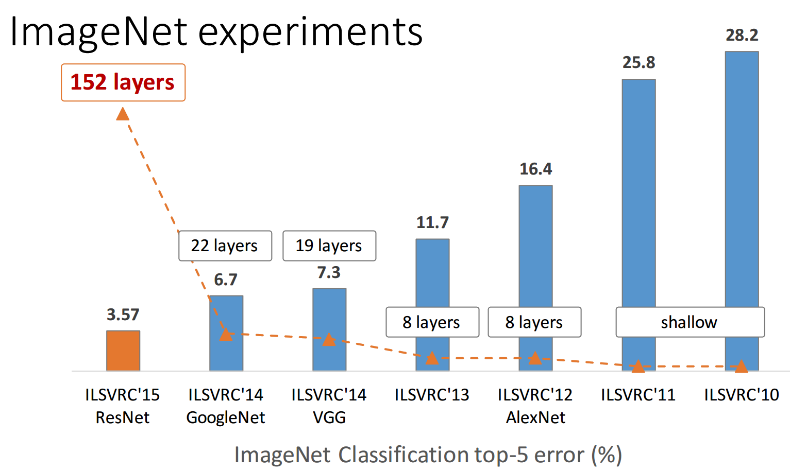
Deeper is better
from Kaiming He slides "Deep residual learning for image recognition." ICML. 2016.

Slide 66
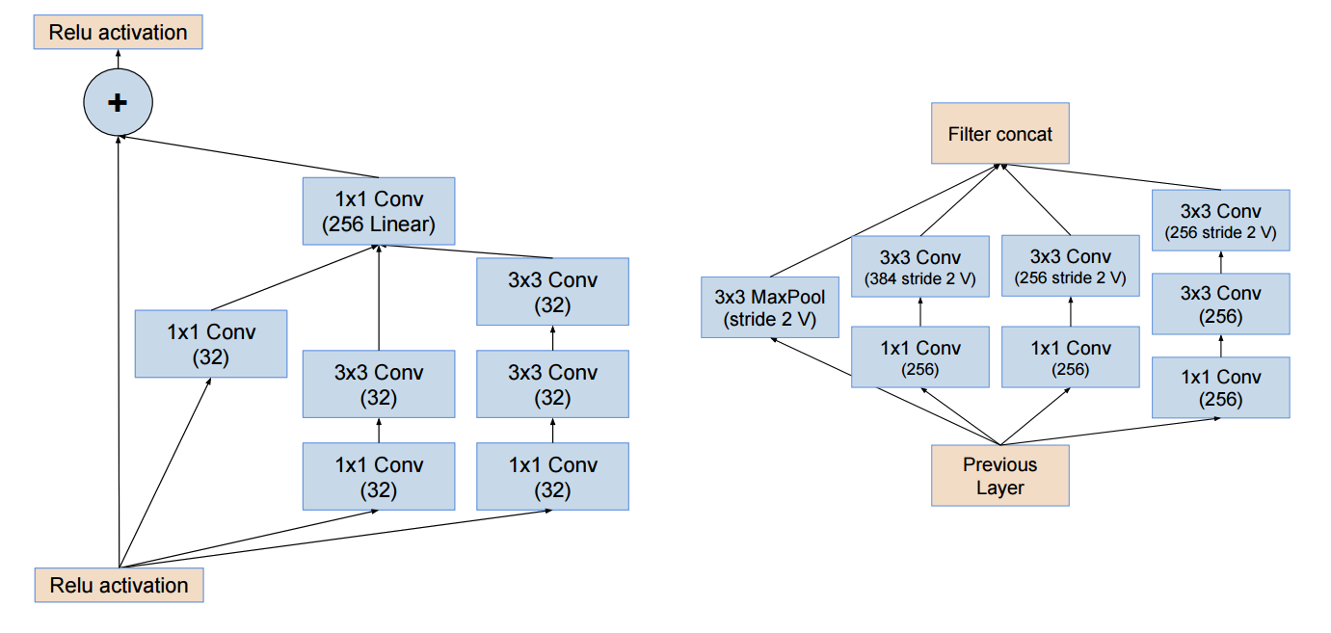
State of the art
Finding right architectures: Active area or research
Modular building blocks engineering
from He slides "Deep residual learning for image recognition." ICML. 2016.

Slide 67
State of the art
Finding right architectures: Active area or research
Modular building blocks engineering
see also DenseNets, Wide ResNets, Fractal ResNets, ResNeXts, Pyramidal ResNets
from He slides "Deep residual learning for image recognition." ICML. 2016.

Slide 68
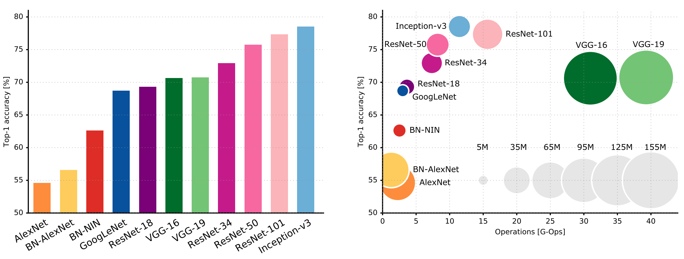
State of the art
Top 1-accuracy, performance and size on ImageNet
See also: https://paperswithcode.com/sota/image-classification-on-imagenet
Canziani, Paszke, and Culurciello. "An Analysis of Deep Neural Network Models for Practical Applications." (May 2016).

Slide 69
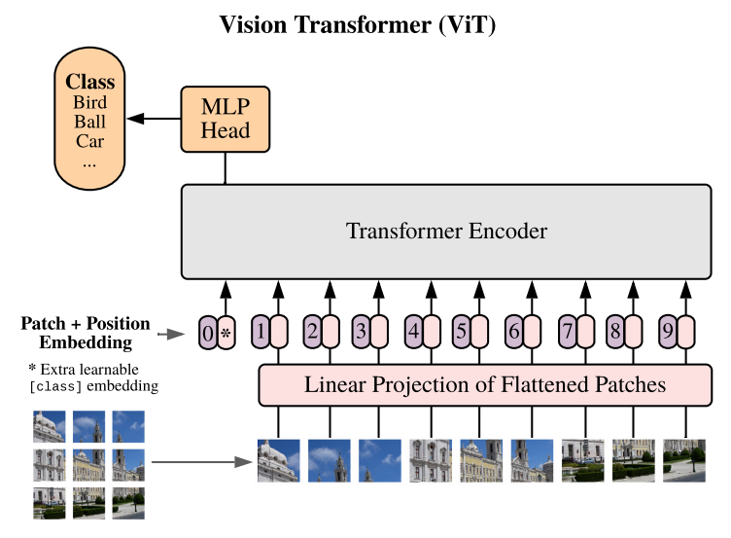
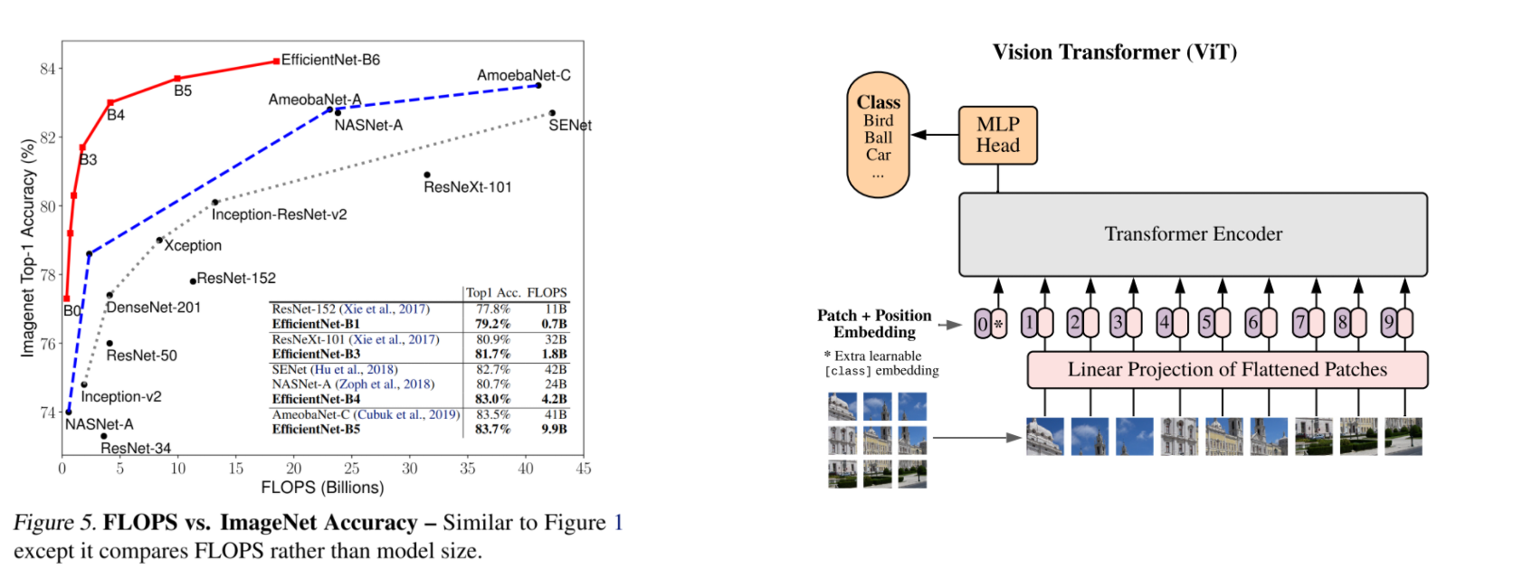
More ImageNet SOTA
Mingxing Tan, Quoc V. Le, EfficientNet: Rethinking Model Scaling for Convolutional Neural Networks , ICML 2019.
Irwan Bello, LambdaNetworks: Modeling long-range Interactions without Attention, ICLR 2021
Dosovitskiy A. et al, An Image is worth 16X16 Words: Transformers for Image Recognition at Scale, ICLR 2021
Notes:
Similar to Swin Transformer

Slide 70
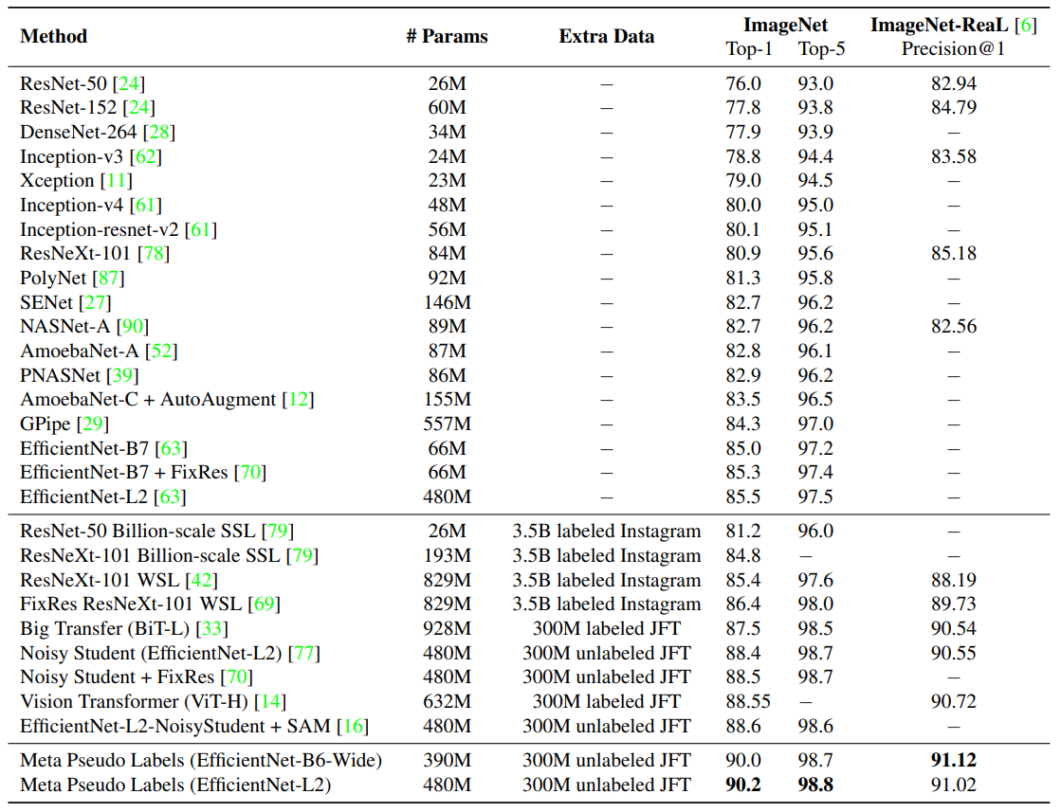
State of the art
Meta Pseudo Labels, Hieu Pham et al. (Jan 2021)
Notes:
Check out Meta Pseudo Labels paper
TRAIN A MODEL TO TRAIN A MODEL AND FIND THE BEST MODEL: Neural Architectural Search: designed to find configurations automatically to find the best architecture and associated parameters that yields a model that produces the best model.
Based on state-action-reward for training the deep reinforcement neural architecture search model for finding the best deep learning models!
So far, it is only comparable to human’s ability to find (build) the good models.

Slide 71
Pre-trained models

Slide 72
Pre-trained models
Training a model on ImageNet from scratch takes days or weeks.
Many models trained on ImageNet and their weights are publicly available!
Transfer learning
Use pre-trained weights, remove last layers to compute representations of images
Train a classification model from these features on a new classification task
The network is used as a generic feature extractor
Better than handcrafted feature extraction on natural images
Notes:
Note: you can take x last layers (as many last layers as you like before output), and freeze all of the other layers that are using the pretrained weights, and just train those last layers you reset/removed with your own training data.

Slide 73
Pre-trained models
Training a model on ImageNet from scratch takes days or weeks.
Many models trained on ImageNet and their weights are publicly available!
Fine-tuning
Retraining the (some) parameters of the network (given enough data)
Truncate the last layer(s) of the pre-trained network
Freeze the remaining layers weights
Add a (linear) classifier on top and train it for a few epochs

Slide 74
Pre-trained models
Training a model on ImageNet from scratch takes days or weeks.
Many models trained on ImageNet and their weights are publicly available!
Fine-tuning
Retraining the (some) parameters of the network (given enough data)
Truncate the last layer(s) of the pre-trained network
Freeze the remaining layers weights
Add a (linear) classifier on top and train it for a few epochs
Then fine-tune the whole network or the few deepest layers
Use a smaller learning rate when fine tuning
Notes:
This is also useful if you want to use a complex model but there is limited amount of data
Smaller data cannot effectively fully train a complex model to maturity.
So using pretrained models and training only some of the layers with the limited data is much more effective.
Remember we can augment the data by changing orientation of the available data/samples to create more data to use for training the model.
Use the pytorch data augmentation library.
Aside from colab, you can use aggle.com , which contains storage space on the server so it is not necessary to download your data set or funnel it in from some online drive space (like google drive).
But note: often you may still not enough memory and computational power to train a complex model, so often after deleting a few layers from the complex, pretrained model, you then train another model that is simpler, then combine that trained simpler model with the complex model that you removed layers from to make room for your simple model that you trained with the limited data set.

Slide 75
WEBSITE FOR DOWNLOADING PUBLICLY AVAILABLE PRE-TRAINED MODELS: huggingface.co
www.huggingface.co

Slide 76
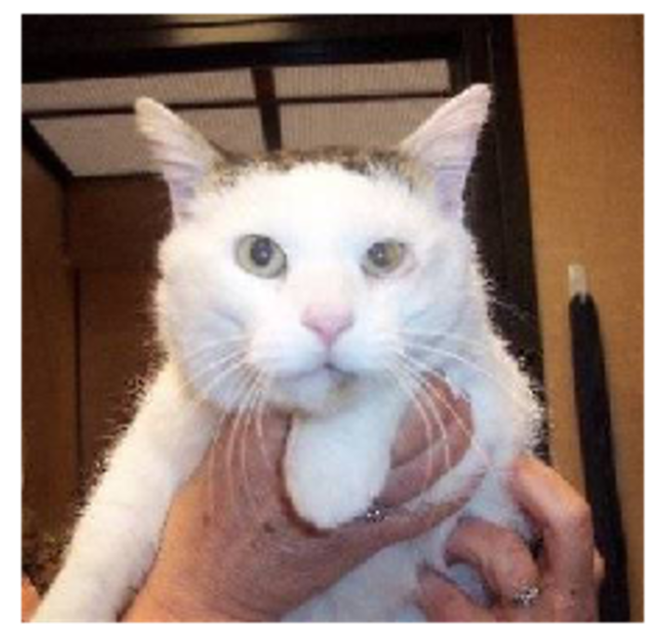
Data Augmentation

Slide 77
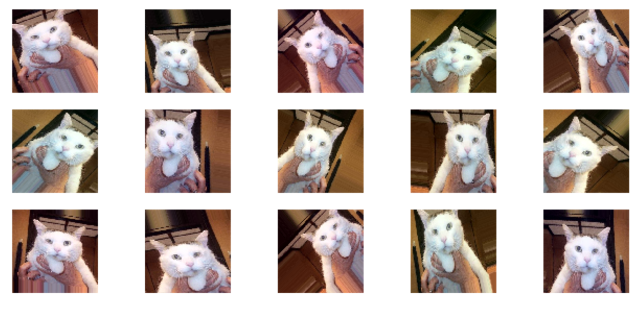
Data Augmentation

Slide 78
Data Augmentation
See also: RandAugment and Unsupervised Data Augmentation for Consistency Training.

